Slide 1


Spidey-Sense Transit
Multimodal Transit Sync & Routing
BUILT ON RAILDETOUR ARCHITECTURE

Slide 2

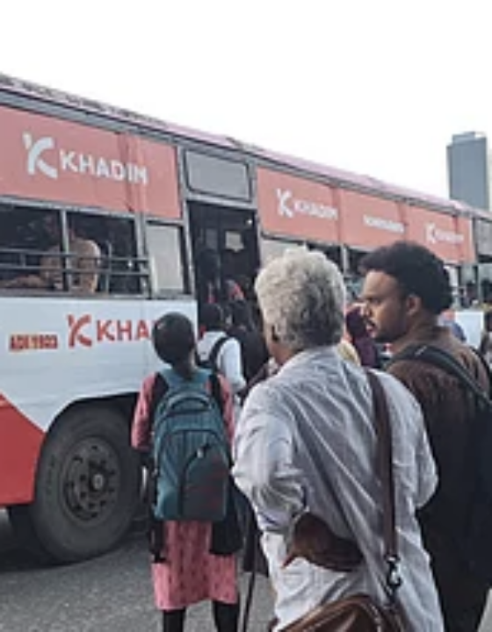
01 / PROBLEM STATEMENT
The Disconnected Commute
Unsynchronized Timetables
Ferries and feeder autos ignore train delays.
Stranded Passengers
Missed connections cost daily wage earners hours.
Invisible Disruptions
Closed level crossings break the last-mile chain.

Slide 3



02 / PROPOSED SOLUTION
A lightweight, community-powered multimodal transit planner.
Crowdsourced Signals
Dynamic Rerouting
Proactive Alerts

Slide 4
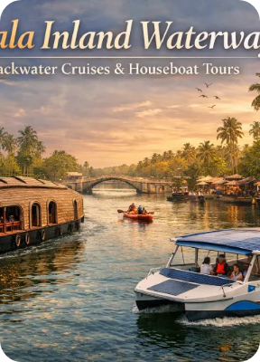


03 / TARGET USERS & USE CASE
Built for the complex Kerala commute.
Daily Commuters
Students
Navigating tight transfers between KSRTC buses and local passenger ferries.
Relying on last-mile feeder autos to reach off-grid campuses safely.

Slide 5
04 / KEY FEATURES
Intelligence at every node.
Transfer Risk Scoring
Community Delay Updates
Automated High/Med/Low risk assessment between modes.
Crowdsourced real-time schedule adjustments.
Multimodal Alternatives
RailDetour Intelligence
Instant fallback generation (e.g., Train → Ferry).
Level-crossing closure prediction and road rerouting.

Slide 6
05 / HOW IT WORKS
Seamless risk mitigation.
1
2
3
4
Plan Journey
Sync Schedules
Flag Risks
Suggest Fallback
Origin, destination, and departure time set.
Cross-reference baseline timetables.
Detect overlapping ETAs via community data.
Provide immediate alternative multimodal path.

Slide 7



06 / TECHNOLOGY & TOOLS
Modern, stateless prototype architecture.
React Frontend
TypeScript
Express Node
Responsive dashboard. LocalStorage state management for hackathon demo limits.
Strict type safety for complex multimodal route data interfaces.
Lightweight API endpoints processing demo transit schedules and risk logic.

Slide 8
07 / PROTOTYPE: TRANSFER RISK UI
Active Journey
Kollam Junction
09:15 AM (Delayed)
Transfer Risk Detected
HIGH RISK
Ashtamudi Ferry Terminal
10:05 AM
Train arrival ETA (09:40 AM) exceeds KSRTC feeder bus departure (09:35 AM). Connection will be missed.
Alternative Multimodal Route
AVAILABLE
Switch to Water Transport.
Train
Walk 5m
09:55 AM Ferry
Recent Report
Train delayed by 25m.

Slide 9
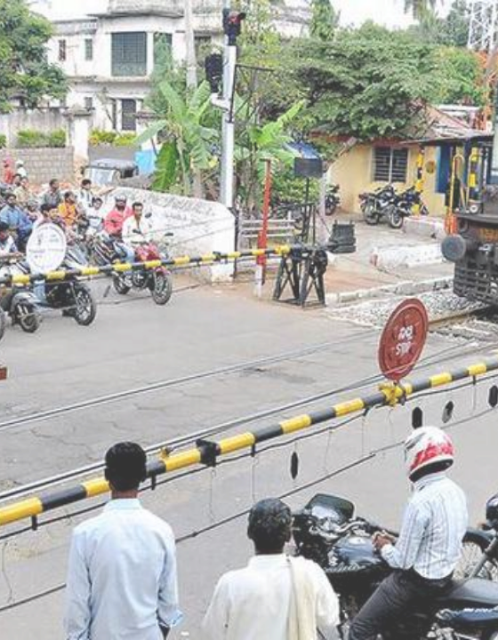
08 / LEGACY FEATURE INTEGRATION
Level crossing awareness preserved.
Original RailDetour crossing intelligence treats trains as dynamic road disruptions.
Route Impact Detected
Feeder auto route blocked by active level crossing. Rerouting via overpass bridge.

Slide 10




09 / INNOVATION
Why Spidey-Sense wins.
Zero API Dependency
Cross-Modal Context
Operates without requiring perfect official transport APIs via crowdsourcing.
Understands that a train delay impacts a ferry schedule, not just the rail network.

Slide 11
10 / FUTURE SCOPE
Next steps for production.
Live GPS integration for KSRTC buses.
Unified ticketing for multimodal journey passes.
Official government API partnerships.

Slide 12
Ready for deployment.
Thank you from the RailDetour team.

Slide 13



Image Sources
https://cf-images.assettype.com/downtoearth%2F2025-05-20%2Flz0ggtcq%2FChennai?w=480&auto=format%2Ccompress
Source: www.downtoearth.org.in
https://keralatourpackages.net/wp-content/uploads/2026/02/Kerala-Inland-Waterways-Cruise.webp
Source: keralatourpackages.net
https://indiainfrahub.com/wp-content/uploads/2020/11/24BGRAILWAY1.jpg
Source: indiainfrahub.com

